Slide 1
CAPSTONE PROJECT
Sales Analytics

Slide 2
Publications
The dashboard offers insights into author performance based on book sales, royalties, and genre preferences. It highlights the top-performing authors by revenue and volume, allowing stakeholders to identify valuable contributors. Trends in author popularity over time help forecast future performance and reader interest. This data supports better author engagement and royalty planning for the business.
Author Analysis
This section focuses on publisher contributions to overall sales, title availability, and market reach. It compares sales figures across publishers, revealing which partnerships drive the highest returns. The dashboard also tracks delivery timelines and regional distribution of publishers. These insights assist in evaluating publisher efficiency and renegotiating contracts for better outcomes.
Publishers Analysis
The dashboard examines individual book titles to determine their sales performance, reader popularity, and contribution to overall revenue. It identifies bestsellers, underperforming titles, and seasonal favorites, enabling more strategic inventory and marketing decisions. Detailed metrics such as units sold, average price, and returns provide a clear picture of each title’s performance. This helps prioritize top titles and plan reprints or discontinuations.
Title Analysis

Slide 3
This section gives a comprehensive overview of sales performance across time, channels, and discount structures. It visualizes monthly, quarterly, and yearly sales trends, offering clarity on growth patterns and peak seasons. The dashboard also explores the impact of discounts and pricing changes on total revenue. These insights help refine the company’s pricing strategy and promotional planning.
Sales Analysis
The dashboard evaluates store-level performance, tracking metrics such as sales volume, product availability, and regional demand. It identifies high-performing outlets and highlights areas with growth potential. Store comparison helps optimize inventory allocation and improve regional marketing efforts. With this information, the company can enhance store operations and ensure efficient product distribution.
Store Analysis

Slide 4
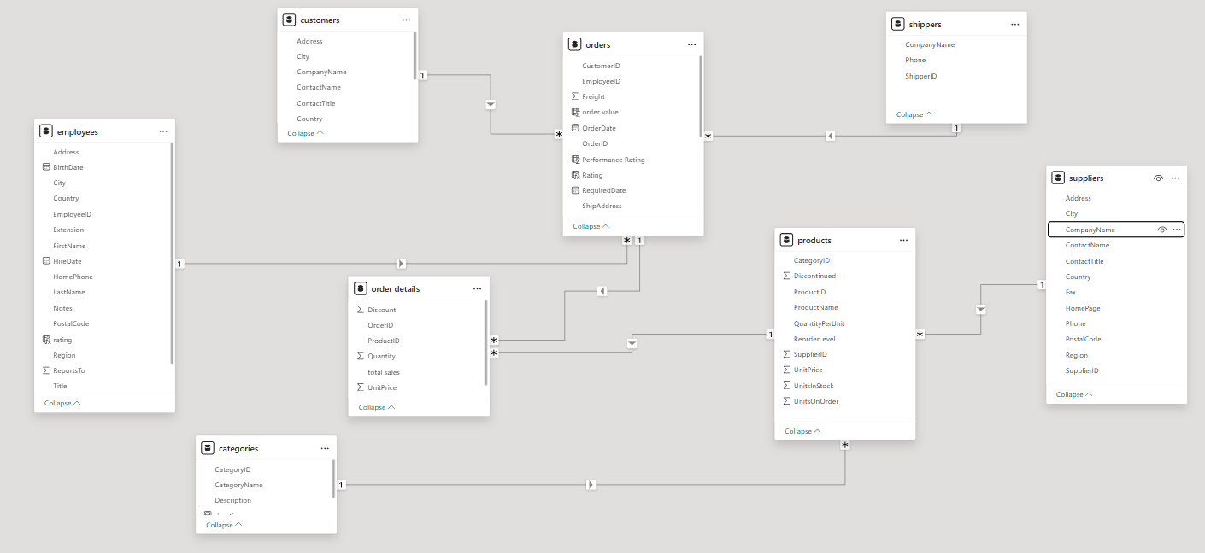
ER Diagram

Slide 5

Power BI Problems statements

Slide 6
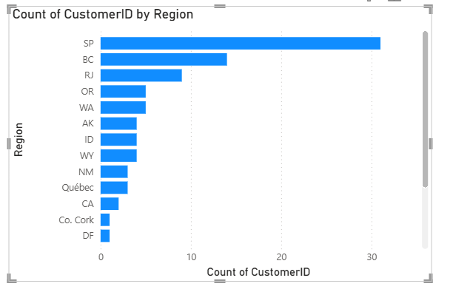
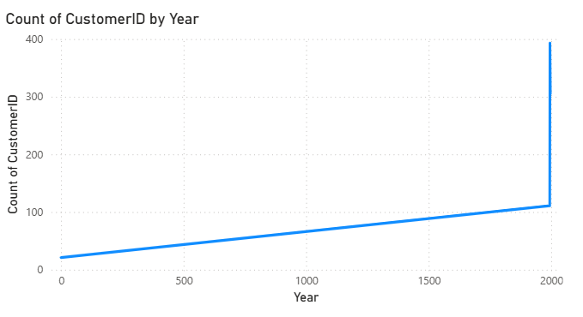
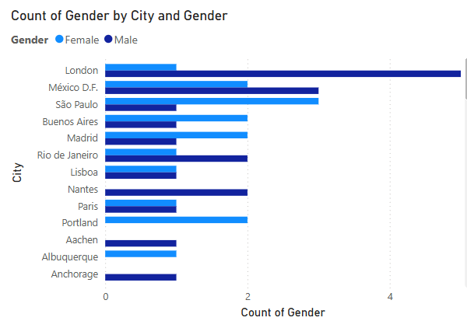

Slide 7
Ho
How does customer distribution vary across different regions or customer segments.
Analys from the chart that regions wise SP, BC, and RJ have the highest number of customers. Regions such as DF, Co. Cork, and CA have low customers. customer distribution is not equal. Some areas have more customer activity than others.

Slide 8
What is the trend in customer acquisition over time? Can we create a line chart or area chart to display it?
The line chart clearly shows that customer acquisition was slow in the early years. However, there is a steep increase the 393 customers are increased count around the year 2000. This indicates a strong upward trend in acquiring new customers in recent years
.

Slide 9
Can we visualize the distribution of customer demographics such as age, gender, or income?
In this figure London have highest male customers
Mexico D.F. and Sao Paulo show a balanced gender
distribution, with nearly equal male and female. counts. Some cities like Portland and Paris have only female customers, while cities like Anchorage and Aachen have only male customers.

Slide 10
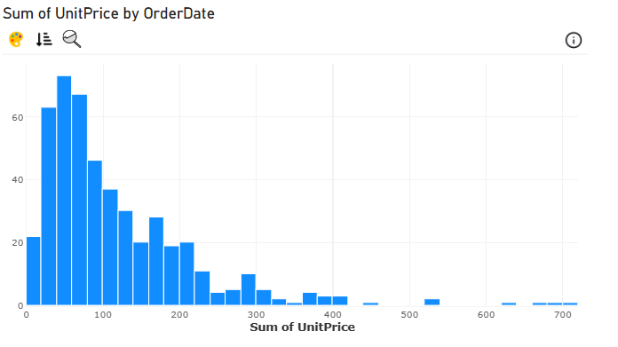
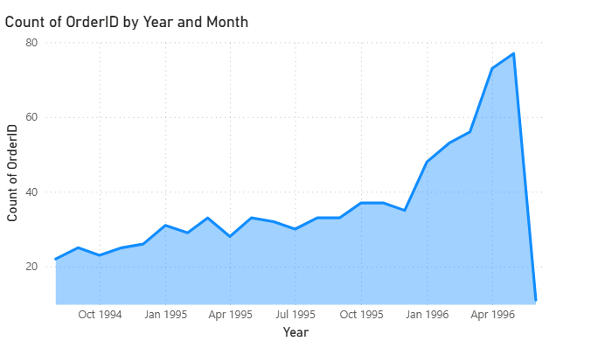
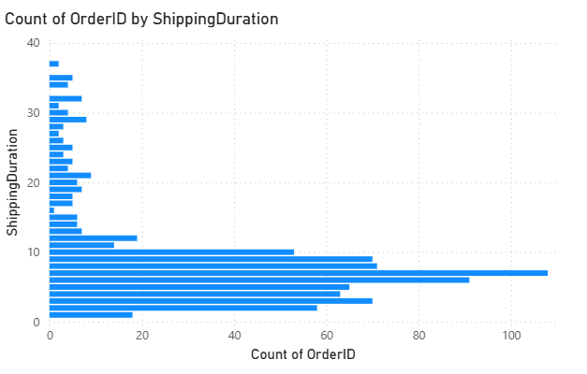

Slide 11
1.How does order volume change over time? Can we create a time series?
The figure shows the count of orders from 1994 to mid-23 orders. 1996 have Order volume remained steady with small fluctuations until late 1995.From early 1996, there was a sharp increase in order count, peaking around mid-1996,have 77 orders.A sudden drop at the end 1996 to 11 orders.

Slide 12
What is the distribution of order values? Can we create a histogram or box plot to display it?
Here the image showing order value based on unit price. The unit is 40 to 59 highest orders are 73 and second highest orders are 67 unit price is 60 to 79.next 62 orders in the unit price of 20 to 39 order value

Slide 13
.Can we visualize the average order processing time or shipping duration?
Most orders are shipped within 5 to 10 days, with the peak at around 6 days, suggesting that the majority of orders are fulfilled in under 10 days. There are fewer orders with long shipping durations, indicating efficient processing and delivery for most.

Slide 14
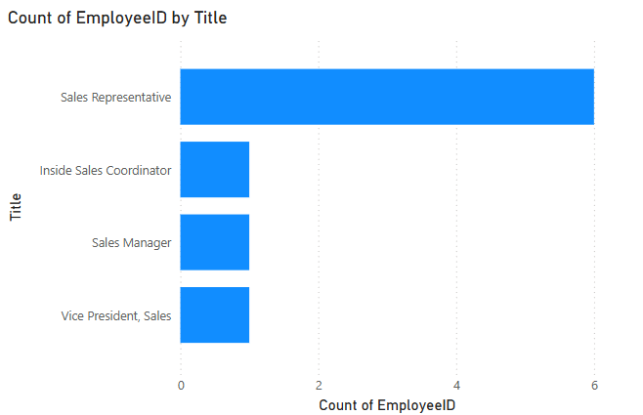
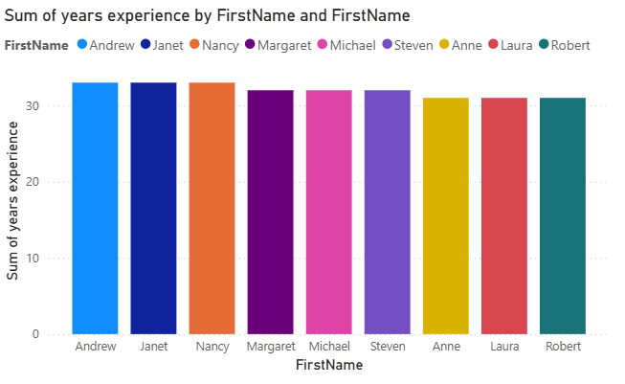
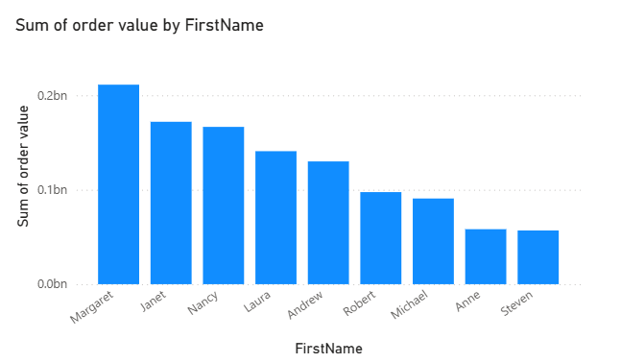

Slide 15
How does employee productivity vary across different departments or job roles?
The Sales Representative role has the highest employee count 6, indicating it is the most populated job title in the sales department. Other roles like Inside Sales Coordinator, Sales Manager, and Vice President, Sales have only 1 employee each, reflecting a lean management structure.

Slide 16
What is the distribution of employee tenure?
The distribution of employee tenure is around 31 years of experience o Andrew, Janet, Nancy. And 32 years of experience To Margaret, Michael, and Steven.33 years of experience To Anne, Laura Robert. This indicates a highly experienced consistency long-term employee

Slide 17
Can we visualize employee performance ratings
In the figure calculating employee performance rating based on the number of orders handled by employee Margaret leads with the highest order value exceeding 0.2 billion, followed by Janet and Nancy. Steven and Anne contribute the least. This disparity highlights top-performing employees

Slide 18
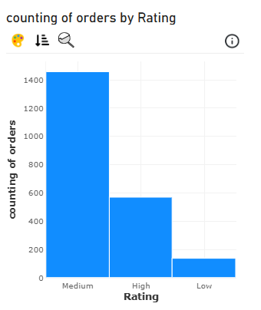
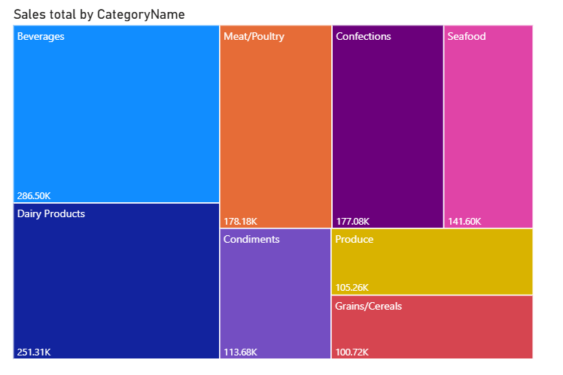
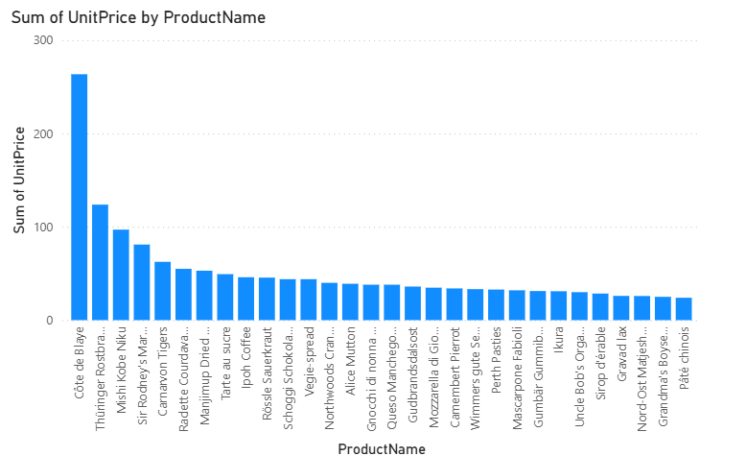

Slide 19
What is the distribution of product ratings or reviews?
In this histogram chart distribution of products rating based on the counting of orders and rating . The majority of products received a Medium rating, indicating average customer satisfaction.
In the medium products have 1400 rating. And in the high rating products have 566 ratings. And lowest products rating have a 110 rating.

Slide 20
How does the sales volume vary across different product categories?
In this Beverages and Dairy Products are the top-selling categories, generating the highest revenue at 286.5K and 251.3K, respectively. Mid-tier performers include Meat/Poultry, Confections, and Seafood, each contributing over 140K. Lower-tier categories like Grains/Cereals and Produce still hold notable sales but may benefit from targeted promotions.

Slide 21
Can we visualize the pricing distribution of products?
The bar chart shows that Côte de blaye has the highest total unit price by a large margin, indicating it is a premium-priced product. Other high-priced items include Thüringer Rostbratwurst and Mishi Kobe Niku, while most products have significantly lower total unit prices. A box plot or violin plot would better illustrate the distribution, spread, and presence of pricing outliers

Slide 22
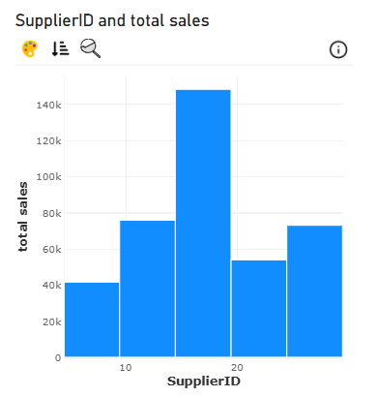
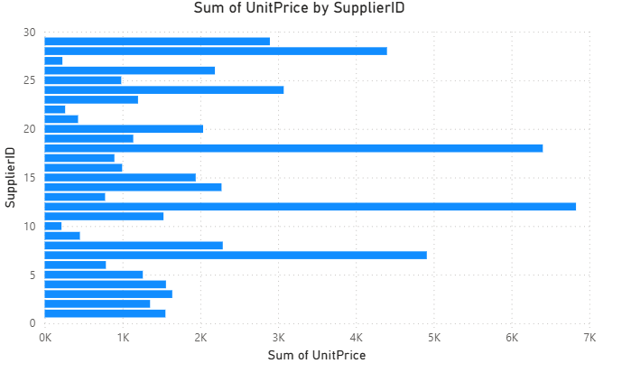
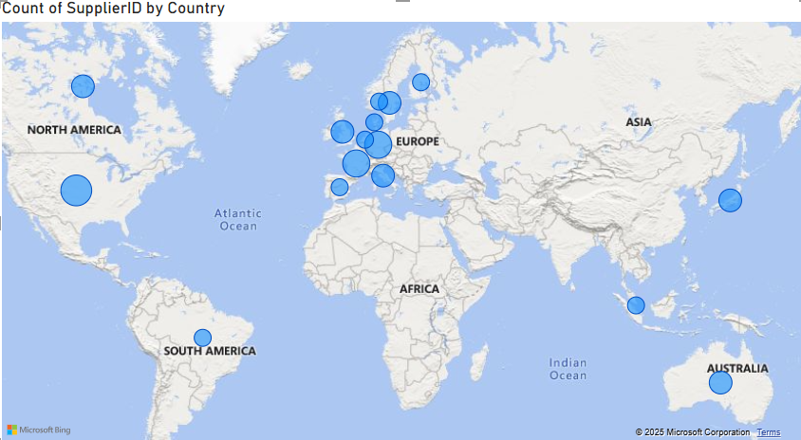

Slide 23
What is the distribution of supplier ratings or performance metrics?
The bar chart shows the distribution of total sales by Supplier id, highlighting variations in supplier performance. One supplier stands out with the highest sales at around $145K, significantly outperforming others. Suppliers with IDs around 10 and 25 also perform moderately well, while others contribute less than $80K. This suggests a few suppliers are key revenue drivers.

Slide 24
How does the cost or pricing structure vary across different suppliers?
The sum of unit prices by Supplier id, highlighting how pricing structures vary across suppliers. A few suppliers—particularly those with IDs around 12, 18, and 28—have the highest aggregated unit prices, suggesting they provide higher-priced or premium products. In contrast, several suppliers have noticeably lower total unit prices, indicating a focus on lower-cost items.

Slide 25
.Can we visualize the geographical distribution of suppliers using a map or bubble chart?
The map shows that the majority of suppliers are concentrated in Europe, especially in countries like Germany, France, and the UK. North America and Australia also have a notable supplier presence, while regions like Asia and South America have fewer suppliers. This suggests a strong European supplier base, possibly due to proximity or product specialization.

